Slide 1
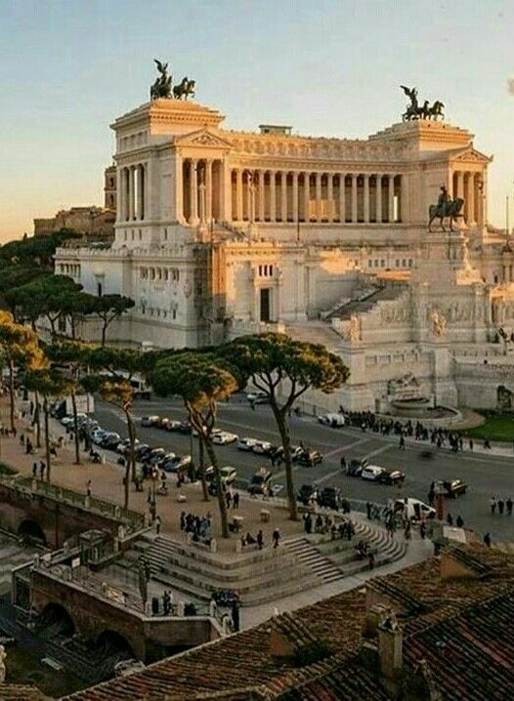
ROME
And her minorities

Slide 2
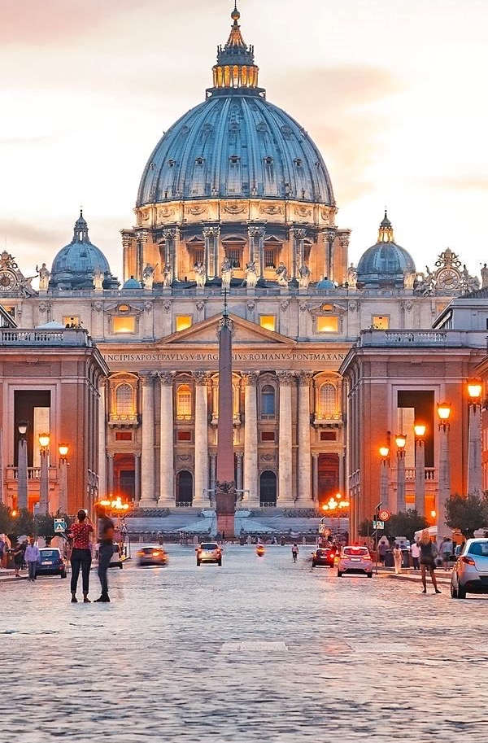
Caput mundi
Rome was founded on 753 B.C. and become very soon one of the most important coomercial hubs of Europe.
During the Renaissance artists from every part of Europe and beyond come in Rome to have a place at the courts of Farnese, Aldobrandini, Borghese and others families who use to pay artists to celebrate themseves.
Many communities, like the muslim one or the Jewish one, lived in Rome since the very beginning of her history and now are integral part of the society (more or less)

Slide 3
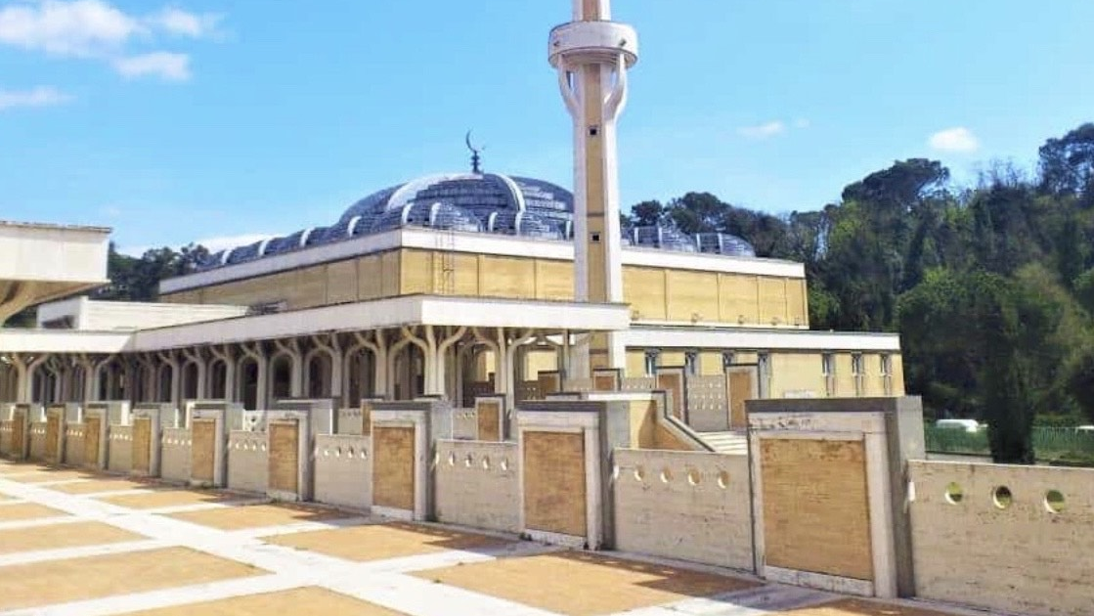
Muslims In Italy Islam is the second most practiced religion after Christianity. In Rome there are more than hundred mosques: the bigger one was built since 1984 to 1994 and is possible to visit it. Relations between Christians and Muslims are pretty good, as the spokesman of the Great Rome’s mosque says, and muslims are now integral part of Italian culture.

Slide 4
jews
Rome has got the eldest Jewish community of all Europe, which settled here in 161 B.C.
During Fascism the Jewish ghetto was raked my the nazists and more than 1023 citizens were deported in stermination camps. Only 16 of them come back home.
Today the Jewish community counts around 45000 individuals. Unfortunately the spokesman of the roman synagogue refers that Jews aren’t properly included in society, as demonstrates the attack occurred in 1982, in which 300 Jews were injuried.

